Slide 1
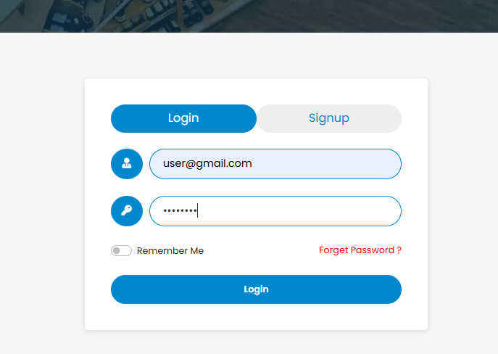
.

Slide 2
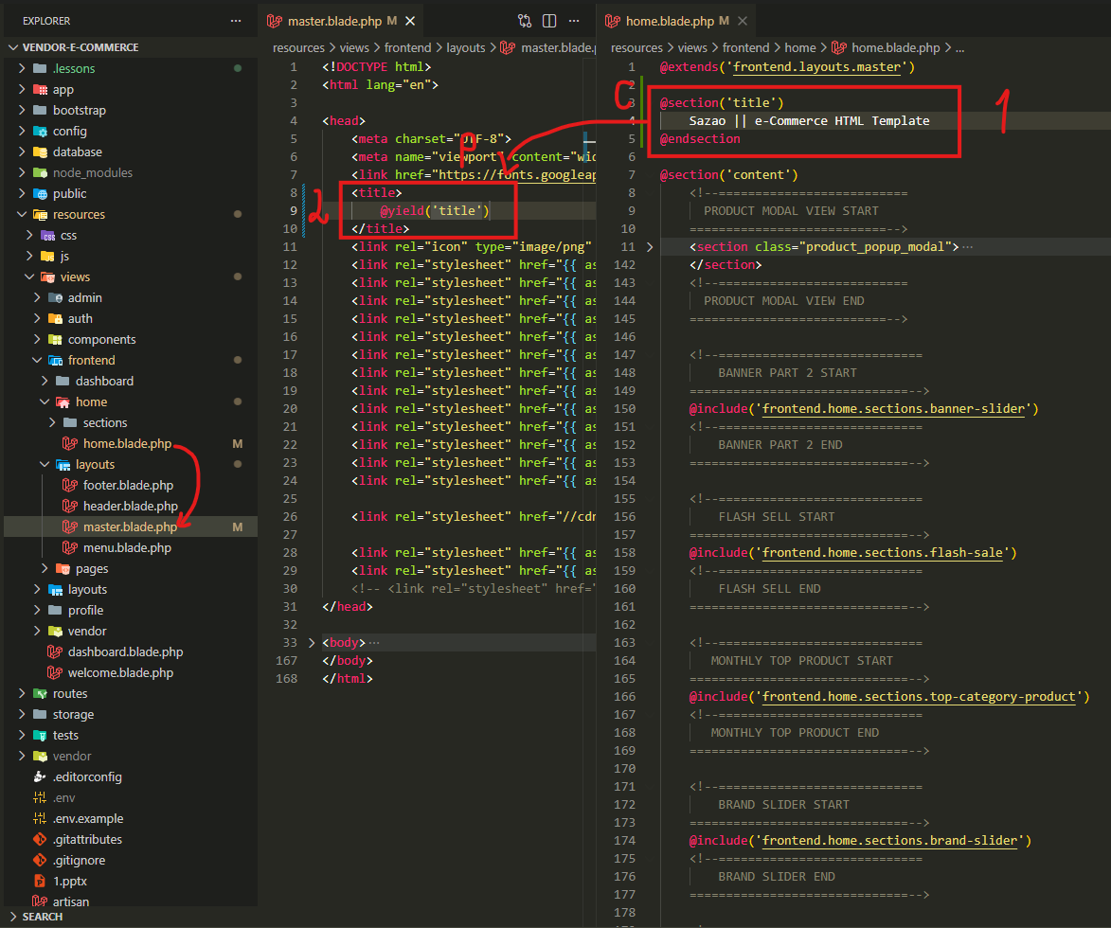
.

Slide 3
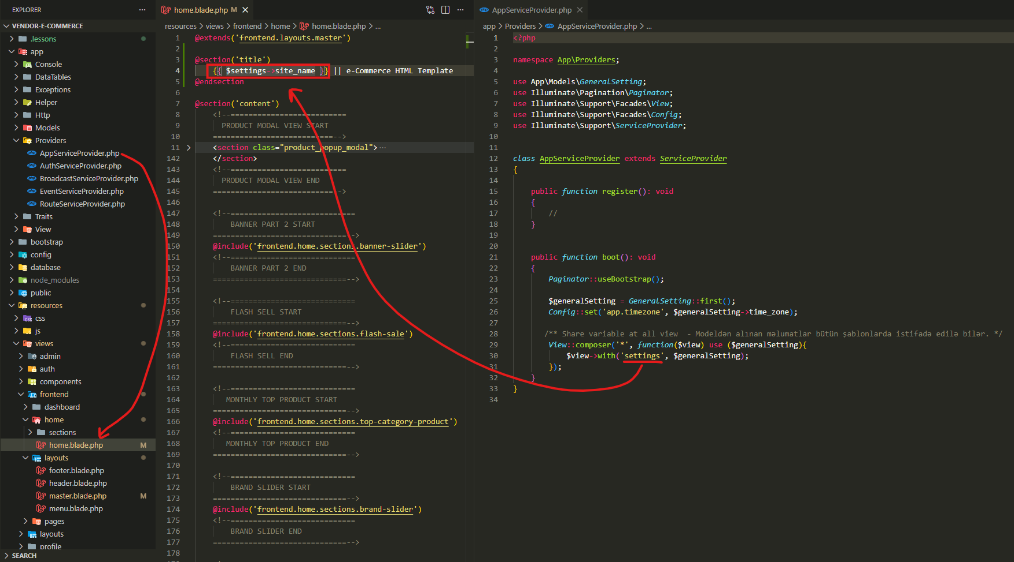
.

Slide 4
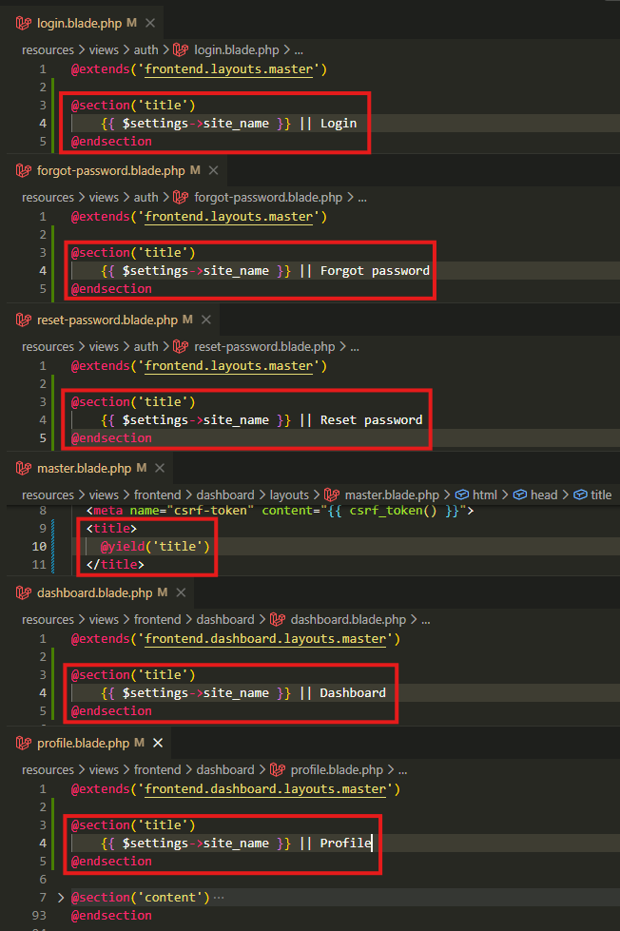
resources\views\auth\login.blade.php
resources\views\auth\forgot-password.blade.php
resources\views\auth\reset-password.blade.php
resources\views\frontend\dashboard\layouts\master.blade.php
resources\views\frontend\dashboard\dashboard.blade.php
resources\views\frontend\dashboard\profile.blade.php

Slide 5
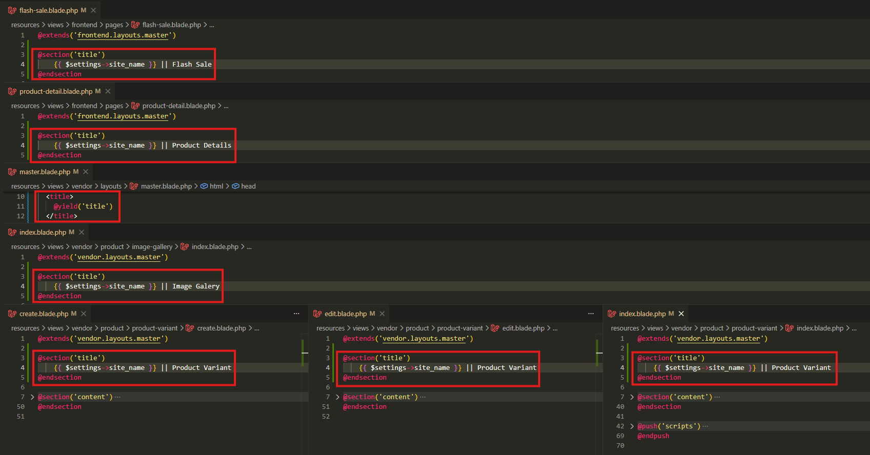
resources\views\frontend\pages\flash-sale.blade.php
resources\views\frontend\pages\product-detail.blade.php
resources\views\vendor\layouts\master.blade.php
resources\views\vendor\product\image-gallery\index.blade.php
resources\views\vendor\product\product-variant\create.blade.php
resources\views\vendor\product\product-variant\edit.blade.php
resources\views\vendor\product\product-variant\index.blade.php

Slide 6
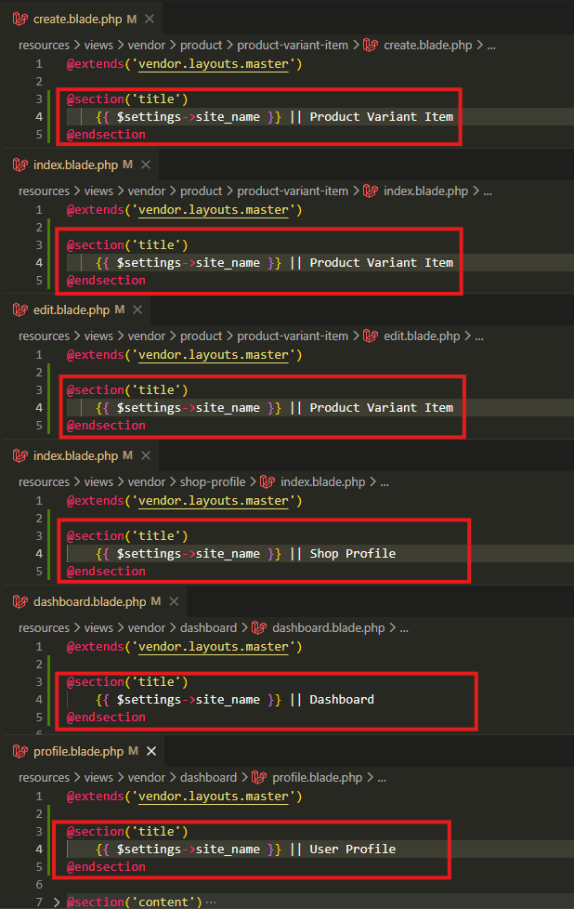
resources\views\vendor\product\product-variant-item\create.blade.php
resources\views\vendor\product\product-variant-item\index.blade.php
resources\views\vendor\product\product-variant-item\edit.blade.php
resources\views\vendor\shop-profile\index.blade.php
resources\views\vendor\dashboard\dashboard.blade.php
resources\views\vendor\dashboard\profile.blade.php

Slide 7
.

Slide 8
.

